Slide 1
Physical View
Dr-Huma Hayat Khan

Slide 2
Overview
How hardware and software work together
Deployment diagrams are used to visualize the topology of the physical components of a system where the software components are deployed.
So deployment diagrams are used to describe the static deployment view of a system. Deployment diagrams consist of nodes and their relationships.

Slide 3
Purpose
The name Deployment itself describes the purpose of the diagram. Deployment diagrams are used for describing the hardware components where software components are deployed.
Component diagrams and deployment diagrams are closely related.
Component diagrams are used to describe the components and deployment diagrams shows how they are deployed in hardware.
UML is mainly designed to focus on software artifacts of a system. But these two diagrams are special diagrams used to focus on software components and hardware components.

Slide 4
so most of the UML diagrams are used to handle logical components but deployment diagrams are made to focus on hardware topology of a system. Deployment diagrams are used by the system engineers.
The purpose of deployment diagrams can be described as:
Visualize hardware topology of a system.
Describe the hardware components used to deploy software components.
Describe runtime processing nodes.

Slide 5
How to draw the deployment diagram?
Deployment diagram represents the deployment view of a system. It is related to the component diagram.
Because the components are deployed using the deployment diagrams. A deployment diagram consists of nodes.
Nodes are nothing but physical hardware used to deploy the application.
Deployment diagrams are useful for system engineers. An efficient deployment diagram is very important because it controls the following parameters
Performance
Scalability
Maintainability
Portability

Slide 6
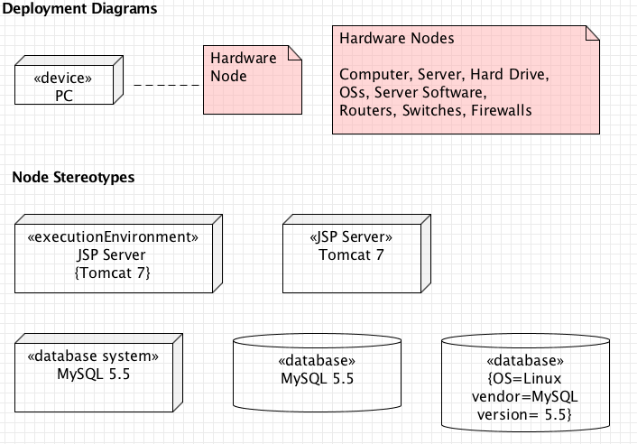
Notations

Slide 7
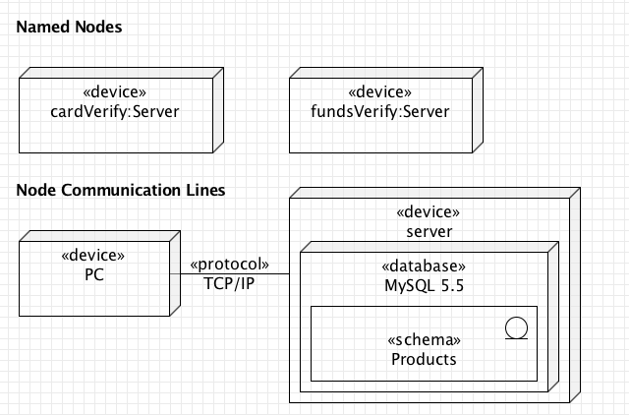
Notations..

Slide 8
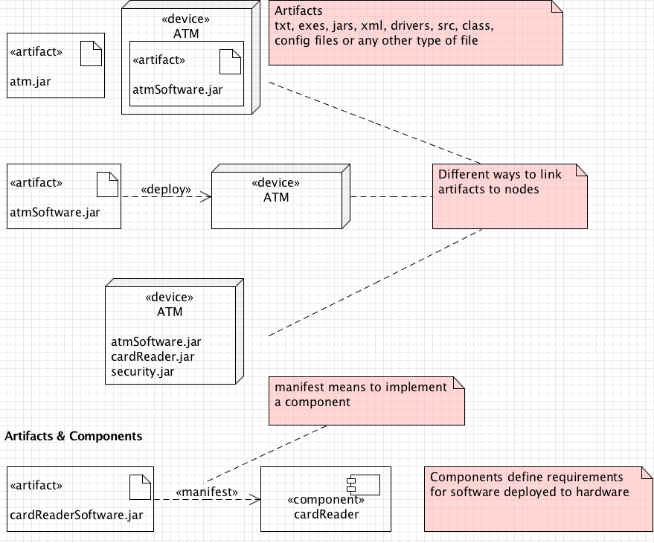
Artifacts

Slide 9
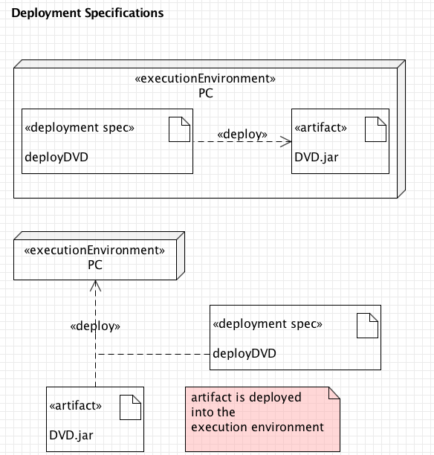

Slide 10
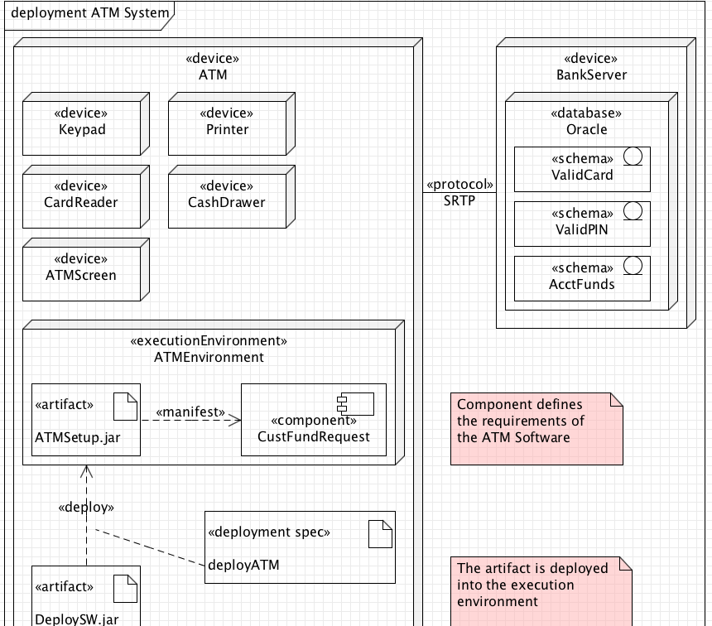

Slide 11
Cont…
The following deployment diagram is a sample to give an idea of the deployment view of order management system. Here we have shown nodes as:
Monitor
Modem
Caching server
Server

Slide 12
Cont…
The application is assumed to be a web based application which is deployed in a clustered environment using server 1, server 2 and server 3.
The user is connecting to the application using internet. The control is flowing from the caching server to the clustered environment.
So the following deployment diagram has been drawn considering all the points mentioned above:

Slide 13
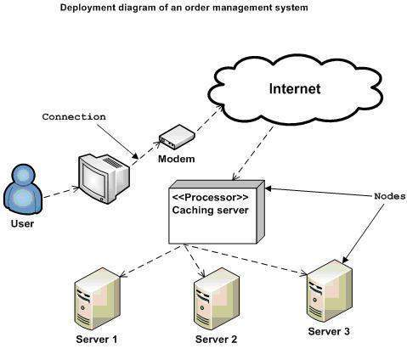

Slide 14
Where to use deployment diagram?
Deployment diagrams are mainly used by system engineers. These diagrams are used to describe the physical components (hardware), their distribution and association.
To clarify it in details we can visualize deployment diagrams as the hardware components/nodes on which software components reside.
Software applications are developed to model complex business processes. Only efficient software applications are not sufficient to meet business requirements. Business requirements can be described as to support increasing number of users, quick response time etc.

Slide 15
Cont…
To meet these types of requirements hardware components should be designed efficiently and in a cost effective way.
Now a day's software applications are very complex in nature. Software applications can be stand alone, web based, distributed, mainframe based and many more. So it is very important to design the hardware components efficiently.
So the usage of deployment diagrams can be described as follows:
To model the hardware topology of a system.
To model embedded system.
To model hardware details for a client/server system.
To model hardware details of a distributed application.

Slide 16
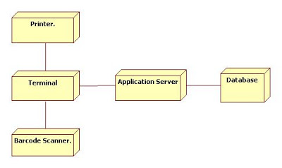
Point Of Sale Terminal (POST)

Slide 17
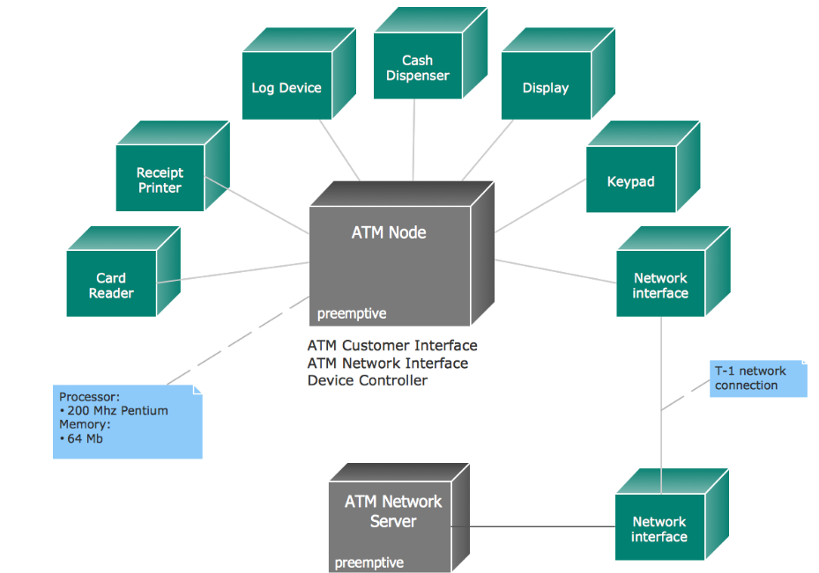
ATM example

